Slide 1




DESAFIO
Gere planos de ação a partir de análises com SQL

Slide 2

Duplique este arquivo, responda e o submeta na plataforma
RESPOSTAS

Slide 3
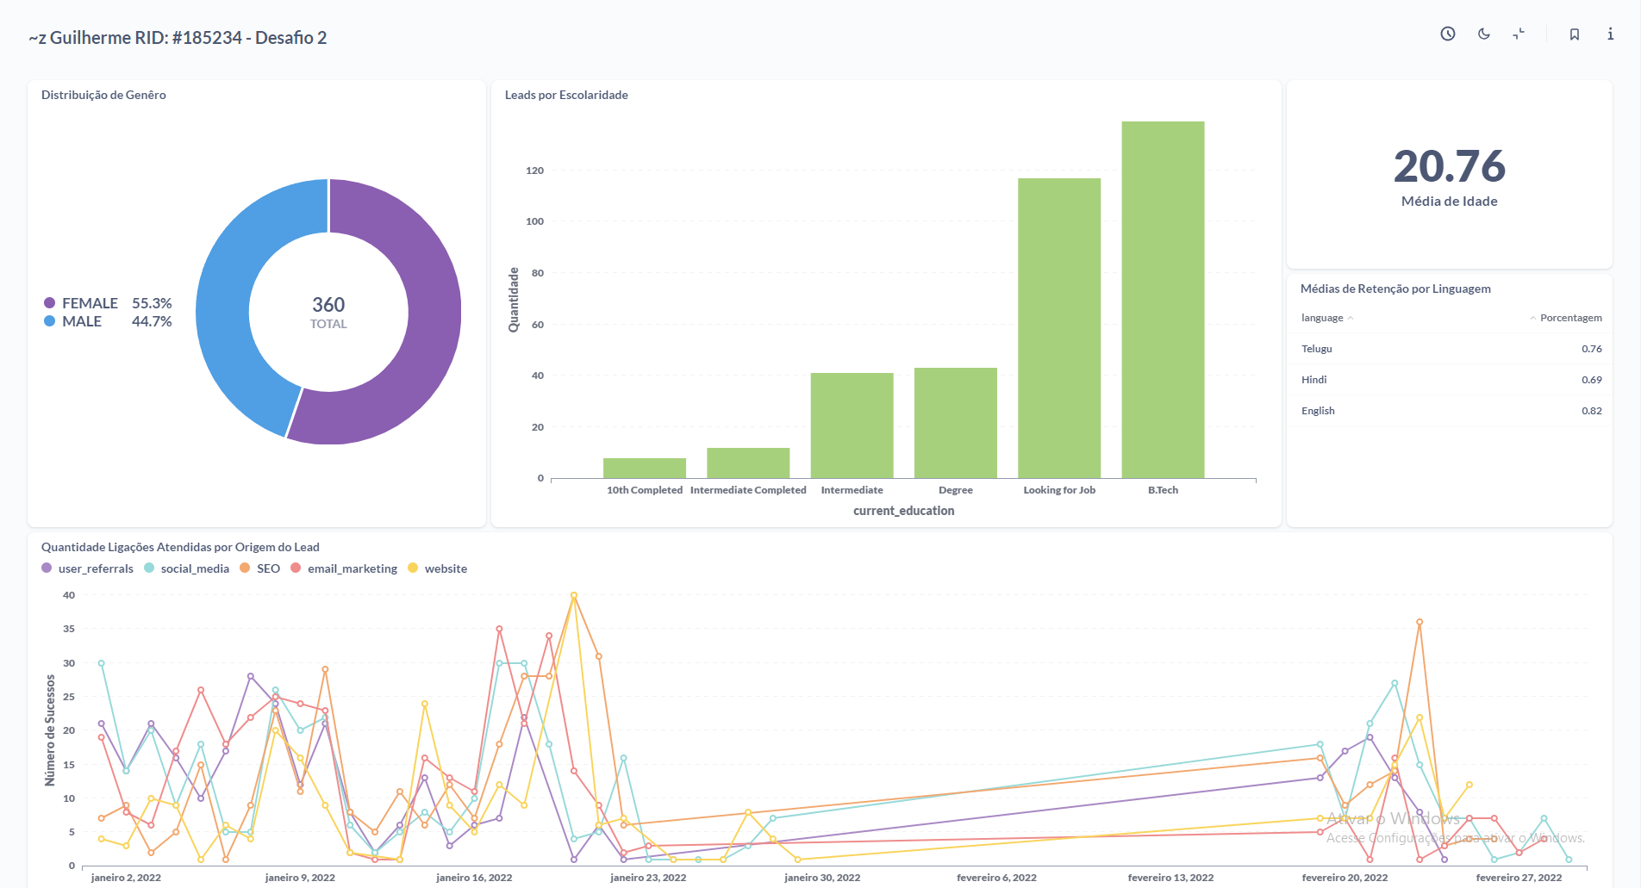
Dashboard
Insira o print do dashboard aqui

Slide 4
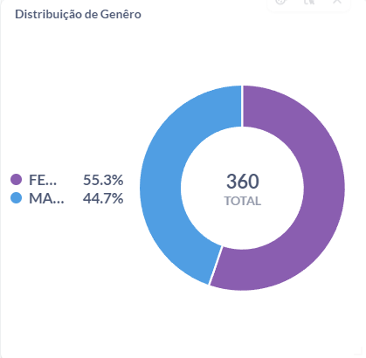
Gráfico 1 - PIZZA
Select gender,count(*)
from leads_basic_details
group by gender

Slide 5
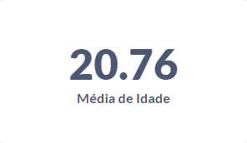
Gráfico 2 - CARTÃO
Select Avg(age) as 'Média da Idade'
from leads_basic_details

Slide 6
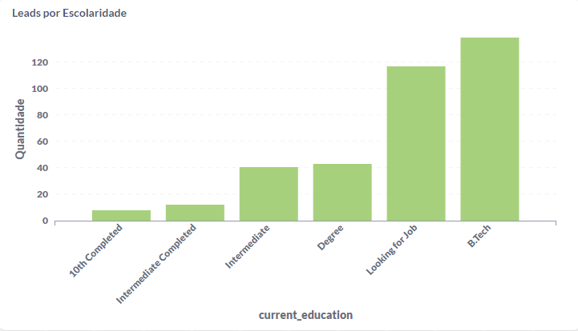
Gráfico 3 - BARRAS
Select current_education, count(*) as 'Quantidade'
from leads_basic_details
group by current_education
order by Quantidade asc

Slide 7
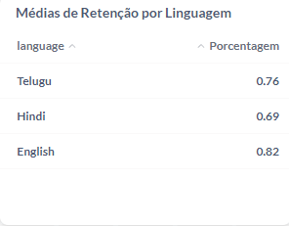
Gráfico 4 - TABELA
Select language, avg(watched_percentage) as 'Porcentagem'
from leads_demo_watched_details
where watched_percentage > 0.5
group by language

Slide 8
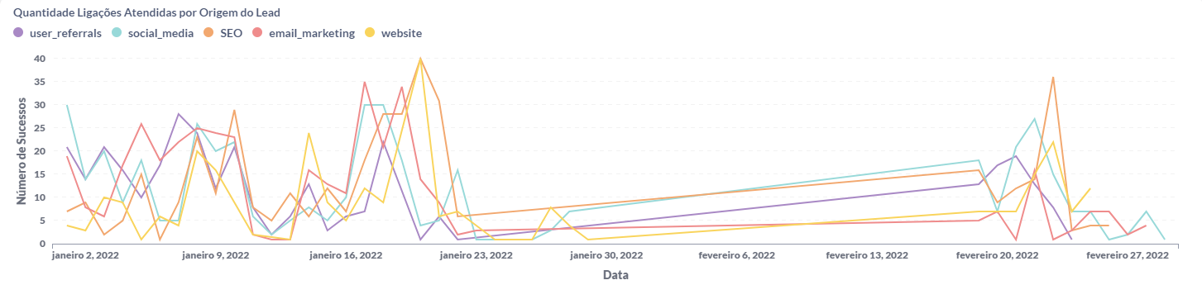
Gráfico 5 - LINHAS
Select call_done_date as 'Data',lead_gen_source,count(call_status) as 'Número de Sucessos'
from leads_interaction_details join leads_basic_details
on leads_interaction_details.lead_id = leads_basic_details.lead_id
where call_status = 'successful'
group by lead_gen_source, Data
order by Data asc

